Slide 1
CS 330 Final Project
TicTacToe
By Brad Schaeffer and Reed Sanders

Slide 2
Index
How to get started
How to join
How to play
How the game is run in the background
Takeaways

Slide 3
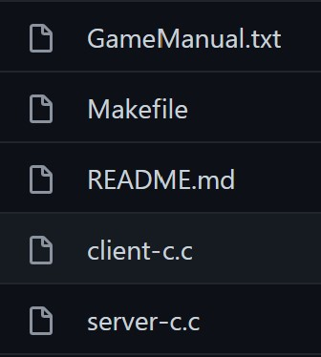
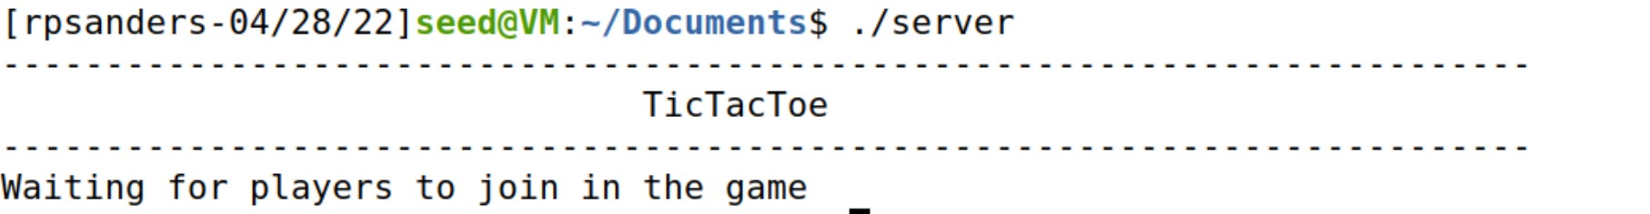
Getting Started
You will have to compile a server.c and client.c
You will have start the server first by running it
Note: server defaults to port 8888
Then you will have to run the client with the server I.P. address and port number
Both client and server should provide feedback if working correctly or an error occurs
All of these steps can also be done by running the Makefile with the “make” command
Example of starting the server

Slide 4
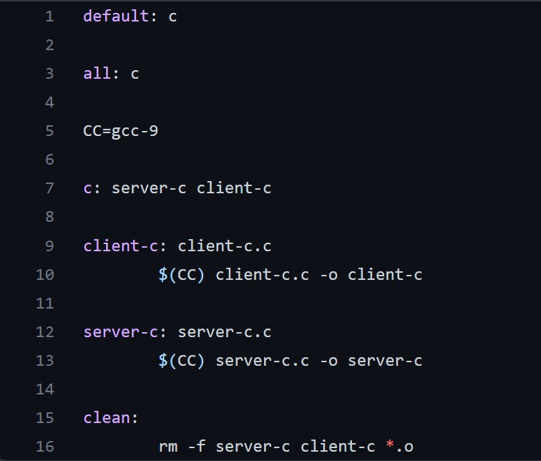
Makefile code

Slide 5
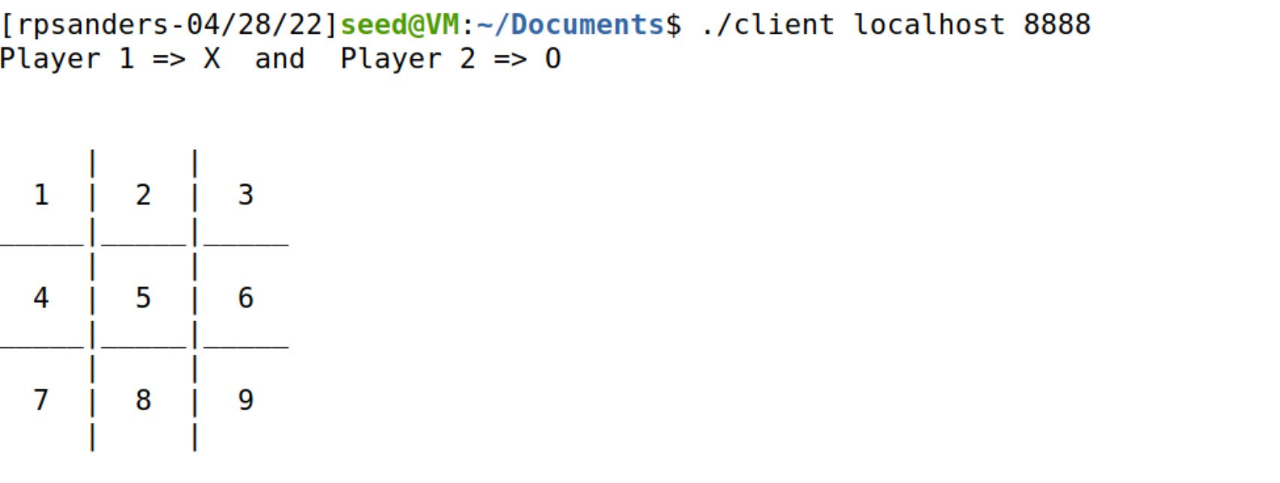
Joining from Client
Notice the boxes are filled with numbers; this is how a Player will enter their next move

Slide 6
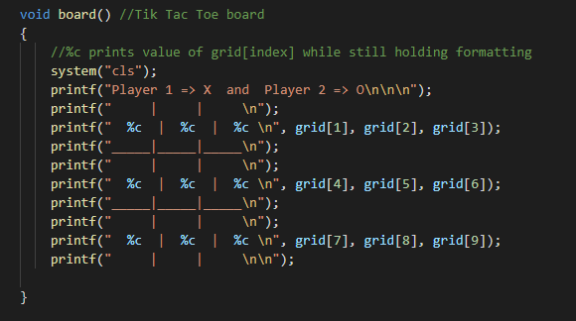
Client Overview Part 1
Grid array is broken down and displayed in TicTacToe format
Users input overwrites a particular grid[index] position

Slide 7
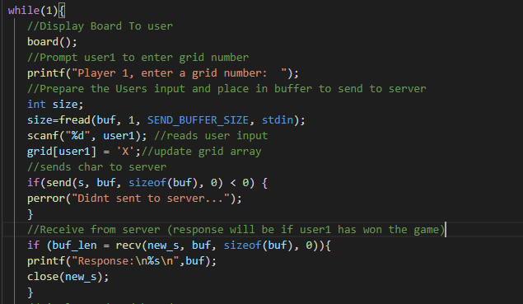
Client Overview Part 2
Example code of what goes on behind the scenes for Player 1
Similar code is executed for Player 2

Slide 8
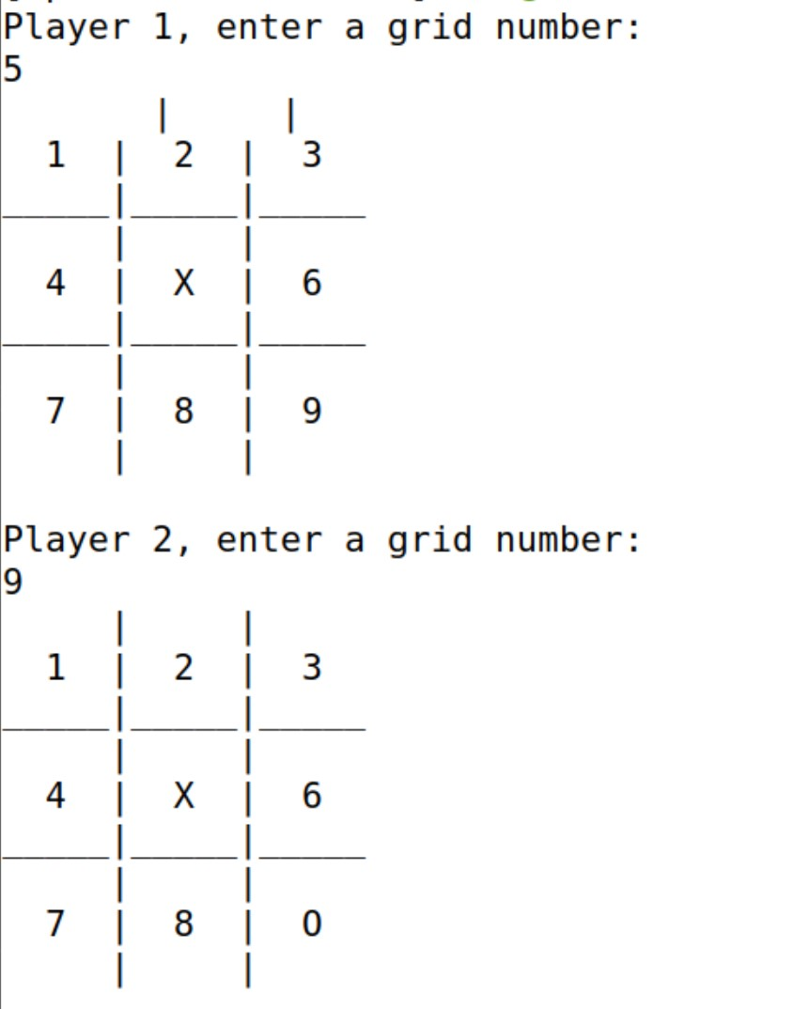
How to Play
Player 1 who is X’s will start
In the example Player 1 selects position 5 by entering the number five and the updated game board is displayed on the screen
Player 2 who is O’s goes next
They want to select position 9 so they enter 9 and the updated game board is shown again and the move goes back to Player 1

Slide 9
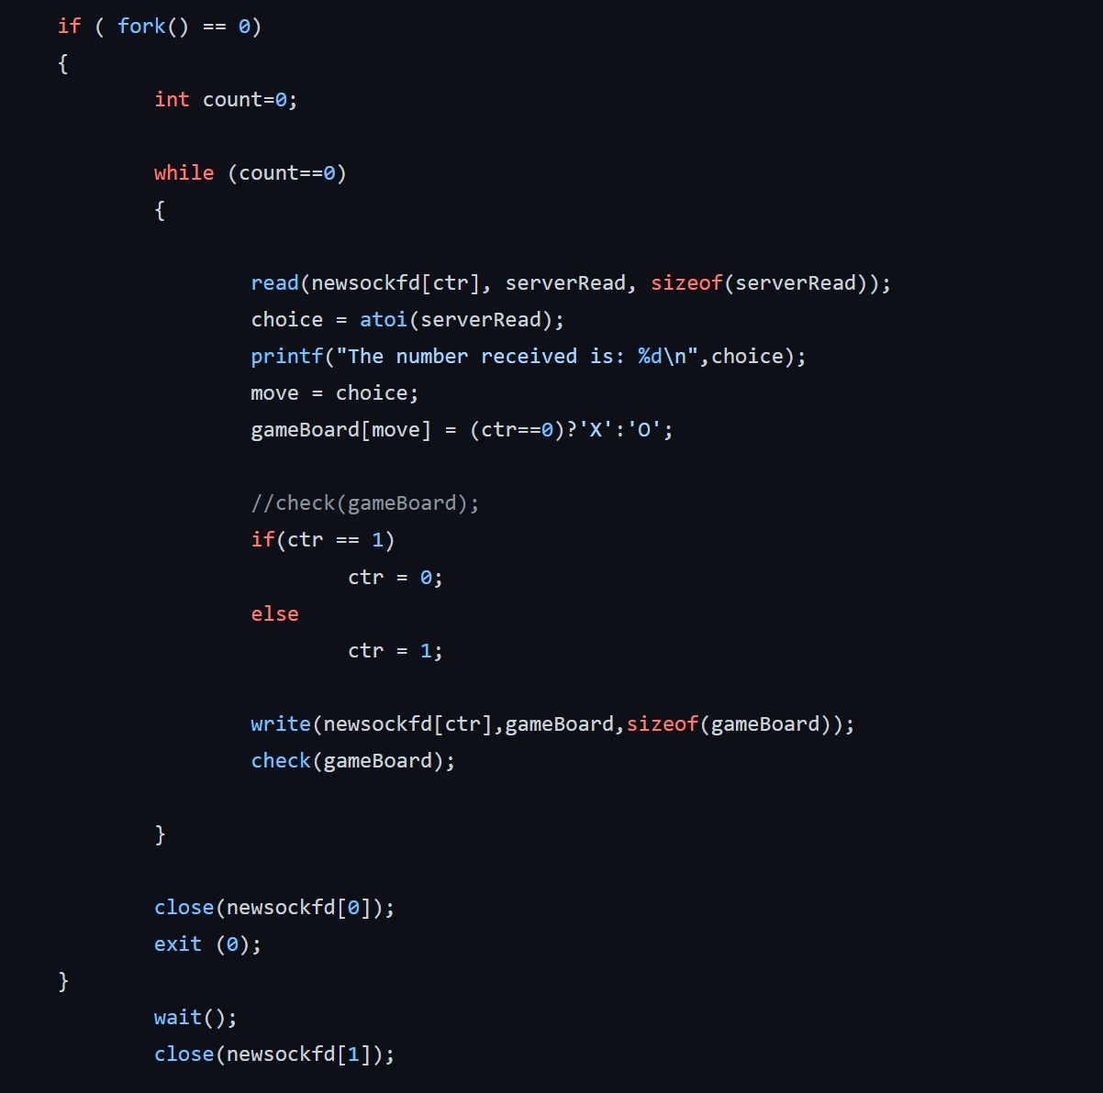
How the game is run
The fork function
Checks the game board for a winner
Adds the moves to the gameboard
Continues until the check function comes back as true
Closes the socket after the game has been won the winner has been reported

Slide 10
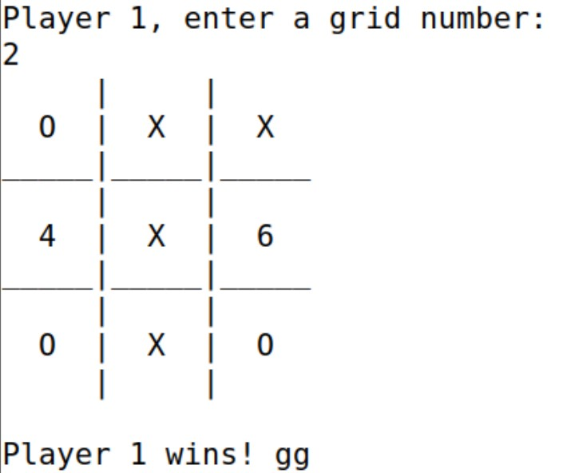
How to Win
At the end of each turn the gameboard is check to see if the player has achieved 3 in a row
In this example Player 1 won by getting three in a row in the middle column
It is then displayed that player one has won the game

Slide 11
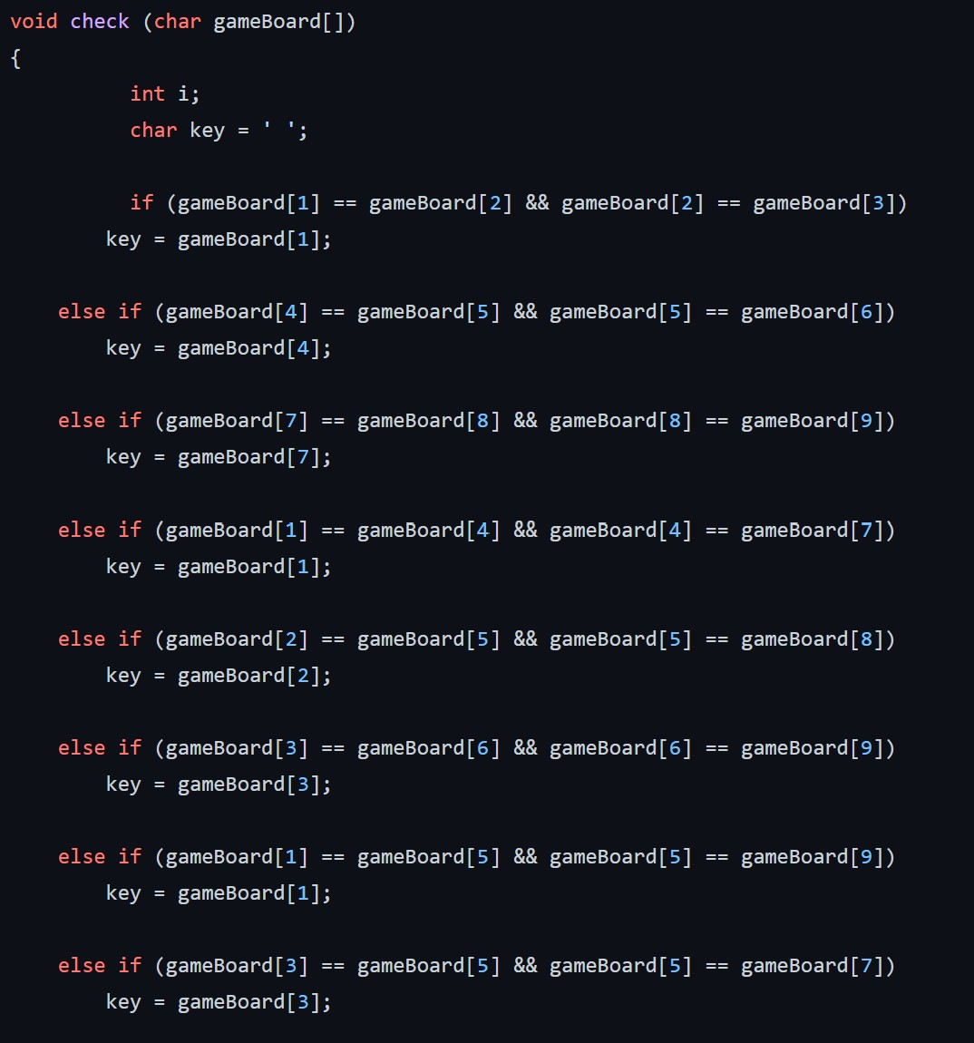
Check Function
Checks to see if either players have completed a row or column or diagonal of three
Check every possible way to win
Is called after every turn
If any of the cases are true it will check it the key is X or O and that determines which player has won

Slide 12
Takeaways
Reed
While using 1-9 in the array instead of 0-8 was more usable for the user it was something that we always had to keep in the back of our mind that we would not be using the 0 position in the array
Client interfaces with the user by gathering grid positions and sends those to the server
Brad
The Server validates if a singular move has already been played before in the game. The server also validates a win and sends a response back to client. The game will end after a win
We split up who made the server and client which created a few extra challenges in trying to get them to connect. We just had to double check our logic on what was being sent over and received

